Slide 1
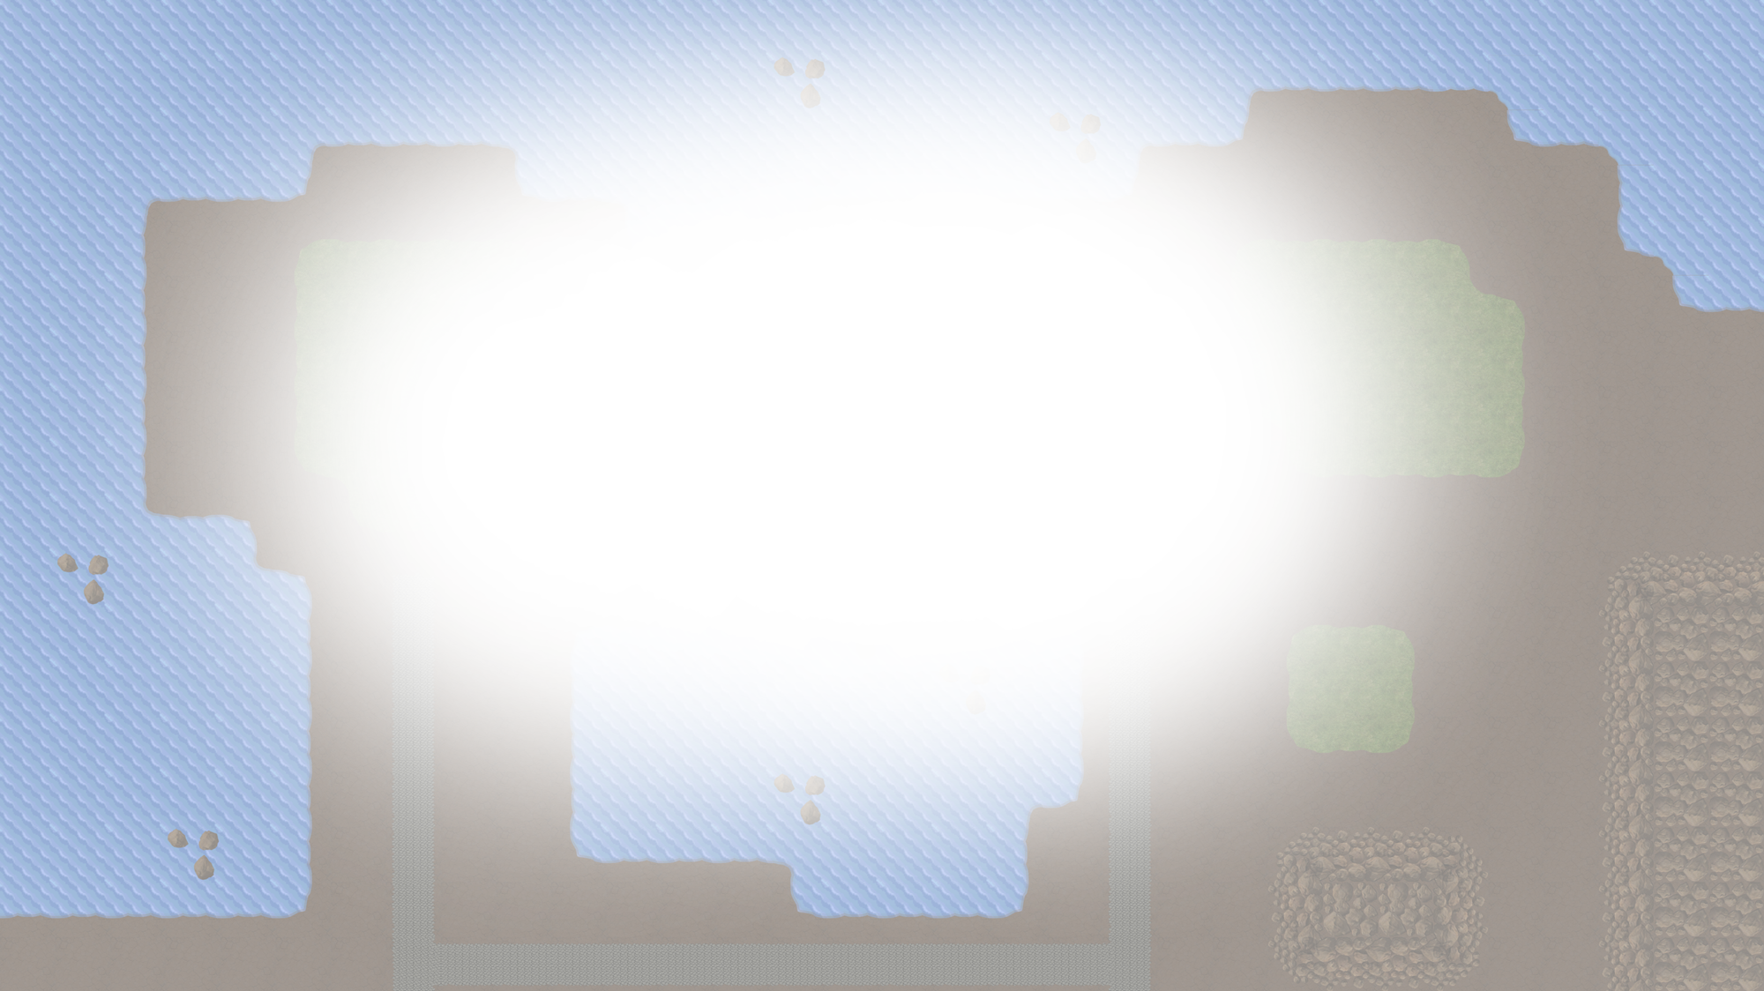






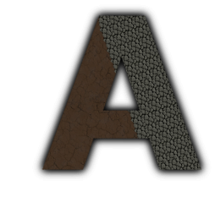


Majaro – Matt, James, Rob
Majario – Matt, James, R(i)ob
Notes:
TOTAL TIME [ 40 – 40 – 30 – 60 > 170s ]

Slide 2
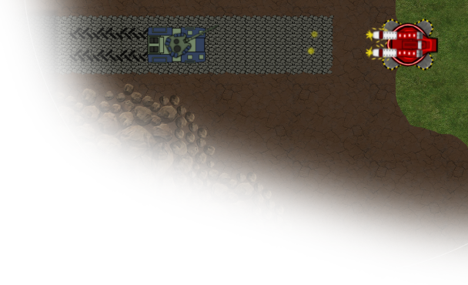
Game Origins
Considered genres;
Reaction (Mario Party)
Simulation (Sims)
Board Games (Risk)
RTS (Age of Empires)
Agreed on an RTS Genre taking inspiration from Command & Conquer Tiberium Twilight
Resultantly we felt by being browser-based for accessibility and by implementing a full top-down implementation our game was unique.
Notes:
ORIGINS [ 40s ]
Considered genres of games which we had all played in the past, suggesting several proposals for ideas and debated why we thought we should make our proposed games.
Voted on our top three favourite proposals and selected the one with most votes, with an RTS style game being the clear winner
Took inspiration from games like Tiberium Sun, Tiberium Twilight, Generals, Star Craft and Age of Empires
Discussed what we thought was missing from our inspirations and what we thought we could achieve in the time we had, with some time spent thinking of future features we could include

Slide 3
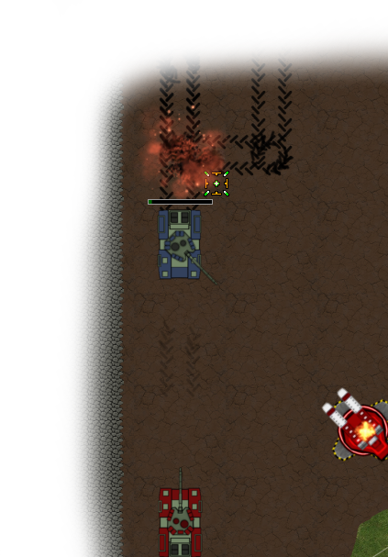
What we did
Created feature plan for the game
Tailored the plan for scalability
Fundamentals implemented first
Once stable extra features were added
Testing occurred semi-regularly
Features tested on implementation
Sam and Steve tested ‘stable’ builds on Fridays
Alpha testing was done by friendly office testers
Notes:
PROCESS [ 40s ]
Drew up a plan of a game including all the features we wanted to be present
Broke the game into development stories prioritising those which created the core game. Our first priority was creating firing turrets and moving tanks
Game was implemented a module at a time until we had a basic and reasonably stable engine which we could expand upon
Testing of the game occurred through user acceptance testing. The game was tested after the addition of each feature. We tried to create a stable build each Friday for testing by Sam and Steve

Slide 4
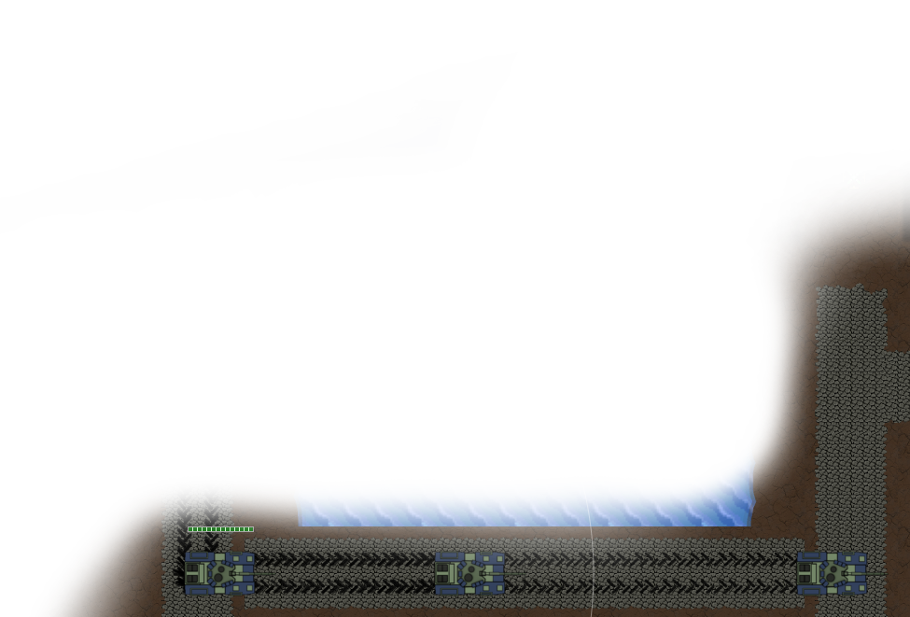
Key Technologies
Backend Server:
Java, Netty, REST Easy, MySQL
Frontend Client:
Angular, Phaser, HTML5, CSS3, SocketIO
Other:
GIMP 2.8, Git, JIRA, Eclipse
Notes:
TECHNOLOGIES [ 30s ]
State the main technologies used in the project and say where they were used/what they were used for
Mention extra detail for each of the above technologies, notably:
Netty : Socket IO implementation
Phaser : Pixi-powered JavaScript game engine
GIMP 2.8 : Creating images/sprites/animations

Slide 5
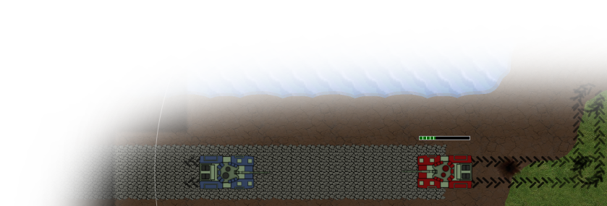
Project Progress Diary
Week 1 :
Brainstorming, Approach to development, Proof of concept for some technologies, Game engine research, Server skeleton constructed
Week 2 :
Game Engine & Netty PoCs, UX web application design, Clientside turrets, Work on Login, Registration & Servers
Week 3 :
Work on UI, Socket server constructed, Work on Game Lobby, Server engine skeleton constructed
Notes:
DIARY 1 [ 60s ]
Week 1 :
Brainstorm ideas for the game
How we would approach the development of it
Created a working proof of concept for various technologies (REST, Java-Tomcat, Angular, MySQL)
Research for best JavaScript game engine
Server skeleton constructed
Week 2 :
Created proof of concept for Phaser game engine and Netty
UX design for web application flow (from login to starting a game)
Turrets constructed on client side in Phaser
Work on Login, Registration & Server Lobby
Week 3 :
UI designed and implemented (stole background image without getting caught)
Began creating socket code for project use
Work on Game Lobby
Constructed skeleton for serverside engine

Slide 6
Project Progress Diary
Week 4 :
Week 5 :
Week 6 :
Week 7 :
Notes:
DIARY 2 [ ]
Week 3 :
UI designed and implemented (stole background image without getting caught)
Began creating socket code for project use
Started work on Game Lobby
Constructed skeleton for serverside engine
Week 4 :
Implemented path finding
Engine working cross computers / browsers
Work on game lobby and server lobby
Week 5 :
Migrated all clientside socket code to single unit (help reduce socket disconnections)
Created two and four player maps
Implemented HUD
Implemented unit/turret lockon/tracking
Implemented damage for units/defences/buildings
Week 6 :

Slide 7
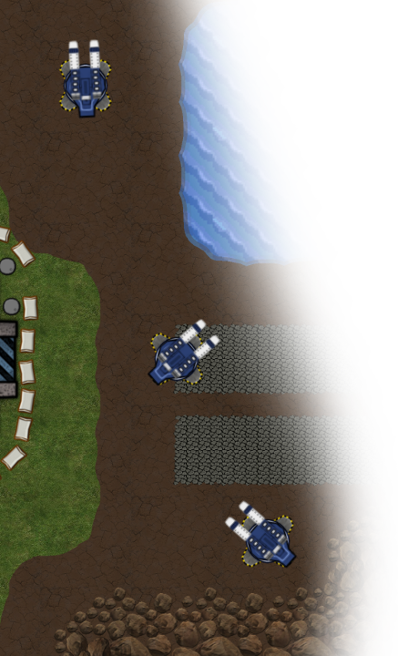
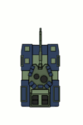
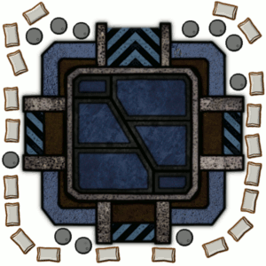
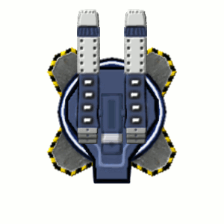
Creating Assets
Created using GIMP 2.8
Original sprite designs

Slide 8
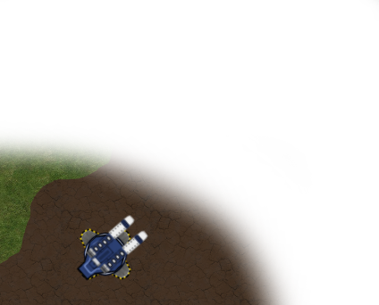
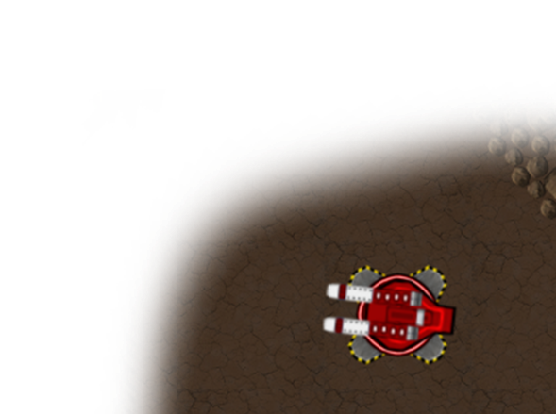

Why we did it that way
When choosing what technologies to use we were mindful to choose those that were available and used within Scott Logic.
For the server we chose to go with Java as it is would enable us to learn a technology more commonly used in project work.
Although there are many options available we chose Phaser.io for graphics handling on the client side as it supported WebGL rendering.
We also opted to use MySQL for the database side of things as it is a freely available yet more than capable solution.

Slide 9
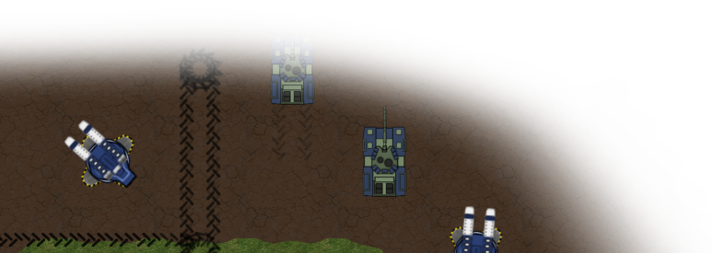
Why we did it that way
By aiming to produce a deliverable at the end of every week, we were able to keep track of our progress as time went on.
Our mentors helped support us in doing this by dedicating one of our stand-ups per week to us demonstrating what we had created so far.
We found user acceptance testing more effective as it enabled us to discover bugs and address gameplay issues simultaneously.

Slide 10
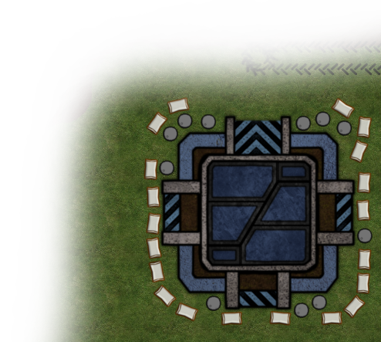
Challenges
Learning new technologies
Java, JavaScript, Phaser primarily
Use of Netty with Java for sockets
Random disconnects cost us a lot of
development time
Original idea was over ambitious
Use of Eclipse and GIT

Slide 11
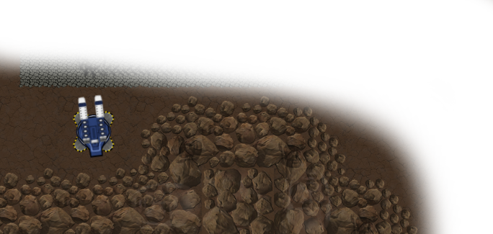

What would we do differently?
Fully plan each week
And stick to this plan rigidly
Implement a single feature at a time
In the form of proper weekly sprints
Use a different IDE

